Slide 1
Building Trust and Sales Ethics
2
Developing Trust and Mutual Respect with Clients

Slide 2
Learning Objectives
L
1
Explain what is trust.
Explain why trust is important.
Understand how to earn trust.
Know how knowledge bases help build trust and relationships.
Understand the importance of sales ethics.
L
2
L
3
L
4
L
5

Slide 3
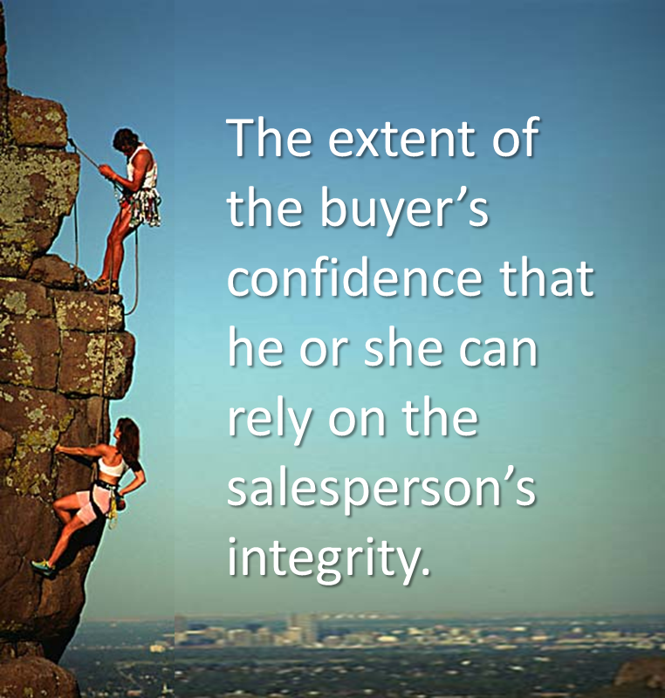
What is Trust?

Slide 4
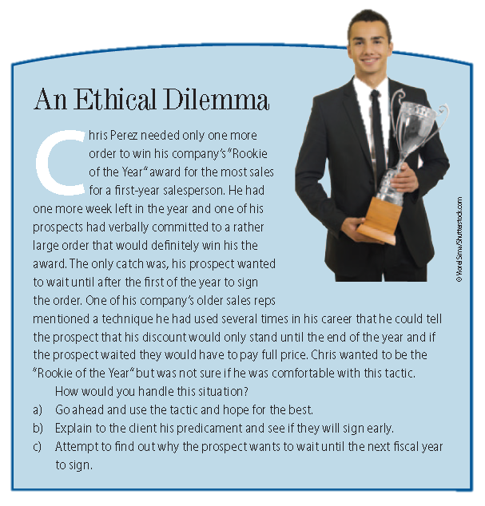
Ethical Dilemma

Slide 5

Why is Trust Important?
A fundamental competitive strategy of a growing number of organizations is to build long-term _________________ relationships with their customers. The ability of those organizations’ salespeople to ____ their customers’ _____ is essential to the success of that strategy.

Slide 6
How to Earn Trust
Trust
Expertise
Customer Orientation
Dependability
Candor
Compatibility

Slide 7
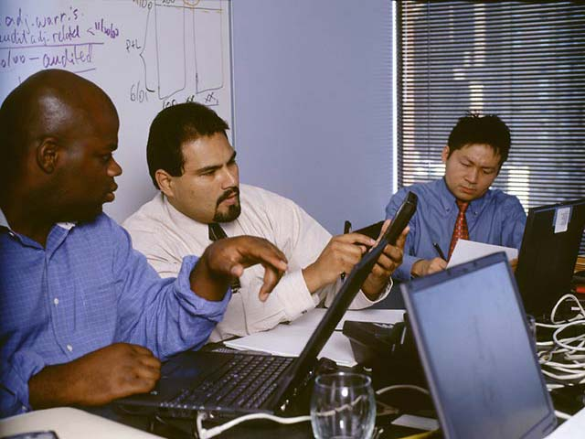
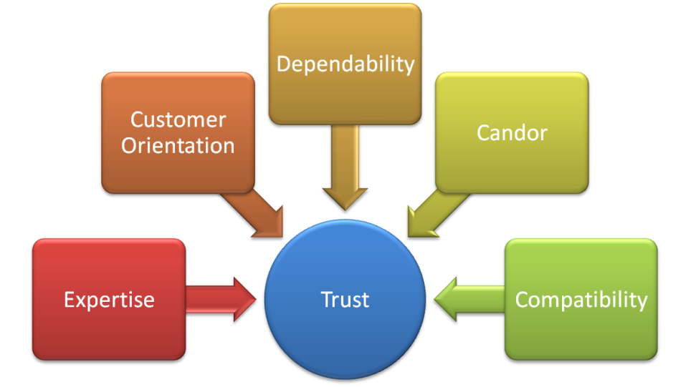
Expertise
The ability, knowledge, and resources to meet customer expectations.
Expertise must translate into observable results and contribution for the buyer.

Slide 8

Dependability
____________ of a person’s actions.
The salesperson must also demonstrate an ability to handle confidential information.

Slide 9

Candor
Honesty of the spoken word. It means ___________ with others, especially with regard to issues/factors that may impact those others.
It takes only one misleading event to lose all credibility.

Slide 10

Customer Orientation
The act of salespeople placing as much emphasis on the __________ _________ as their own.
Salespeople with a customer orientation ______ rather than “sell”.

Slide 11

Compatibility
A salesperson’s commonalities with other individuals.
Customers generally like to deal with salespeople whom they can feel a bond.

Slide 12
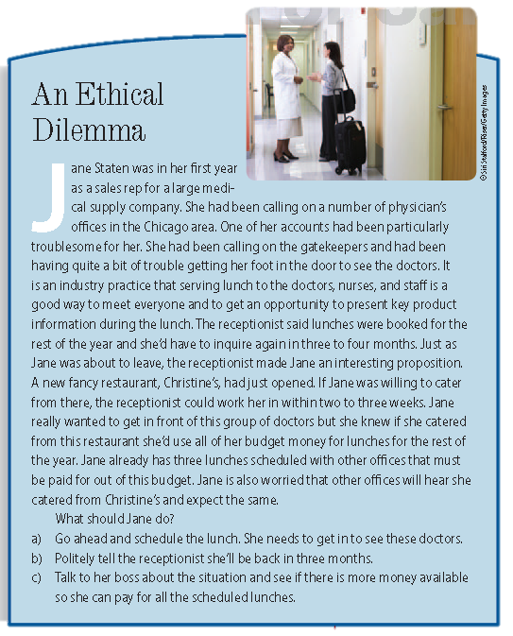
Ethical Dilemma

Slide 13
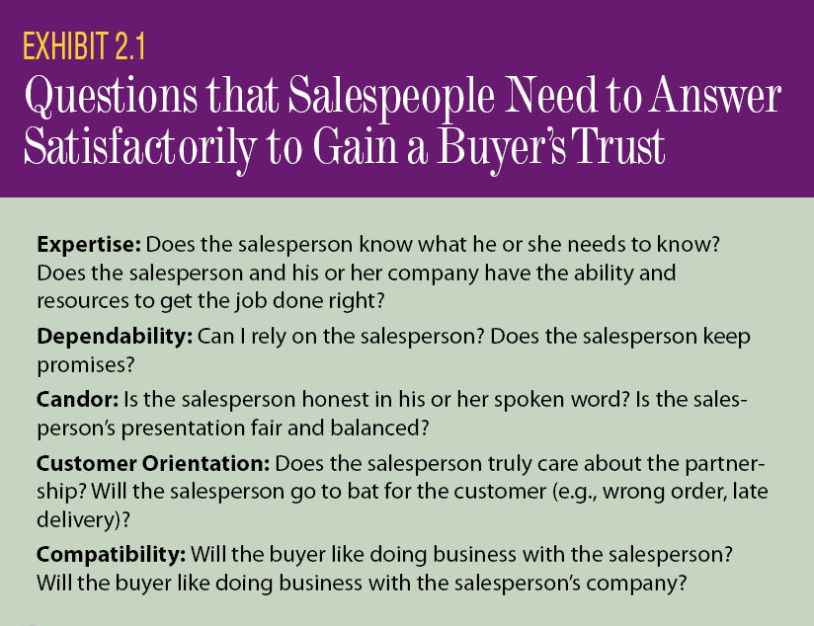
Readiness to Earn Trust

Slide 14

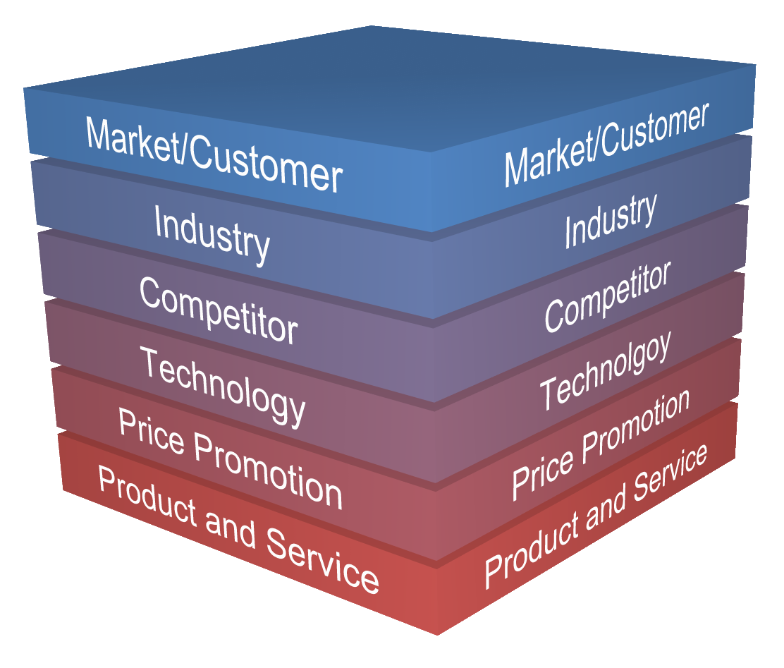
Knowledge Bases Help Build Trust and Relationships
Training
Companies provide _______________ to prepare salespeople for the field.

Slide 15

Training
Enhancing Customer Relationships
Developing Customer Relationships
Initiating Customer Relationships
Selling Techniques
Competitive Knowledge
Market
Product, Price, Channels, Promotions
Company History and Policies
Industry History

Slide 16

Industry Knowledge
Knowledge Need: the dynamics, structure, culture, and forces that affect the industry or industries in which they work.
Benefit: ability to 1) __________________ effective selling strategies, and 2) be viewed as a market information resource.

Slide 17
Company Knowledge
Knowledge Need: understand their company’s culture, mission, goals, policies, and procedures.
Benefit: ability to effectively and accurately ____________________ when interacting (e.g., negotiating) with its prospective and current customers.

Slide 18
Product Knowledge
Knowledge Need: a thorough understanding of their product offerings and the various sources of value they provide
Benefit: be perceived (by the customer) as experts and capable of accurately matching solutions to the needs of the customer

Slide 19
Service Knowledge
Knowledge Need: understand their company’s service capabilities, including limitations, fees, time-frames, and the value they add
Benefit: ability to _____ their company’s service capabilities to the needs of their customers

Slide 20
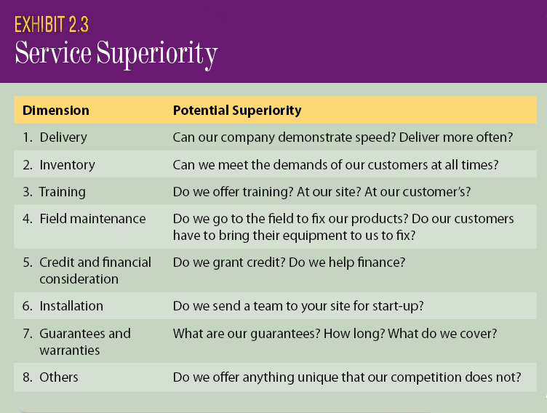
Service Knowledge Areas

Slide 21
Promotion and Price Knowledge
Knowledge Need: understand the details of, and how to manage, promotional programs and the pricing policies of their products
Benefit: ability to 1) _______ their customers’ participation in promotional programs and 2) effectively ________ terms

Slide 22
Market and Customer Knowledge
Knowledge Needs: understand the markets they serve and their customers, including needs, personalities, and communication styles.
Benefit: ability to 1) develop and implement effective selling strategies, and 2) clearly communicate relevant solutions.

Slide 23
Competitor Knowledge
Knowledge Need: their competitors and respective market offers and how they are perceived in the market.
Benefit: to ________ their products against those of their competitors’.

Slide 24
Technology Knowledge
Knowledge Need: understand how utilize sales technology hardware and software (e.g., internet, CRM, laptops, smart phones)
Benefit: to ________________ to me more competitive . . . work smarter not harder

Slide 25
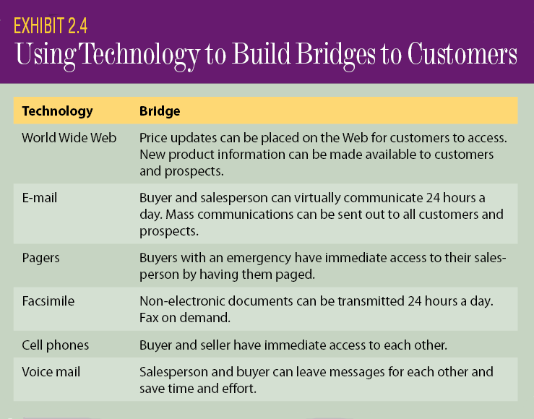
Technology in the Sales Effort

Slide 26

Ethics
Ethics refers to _____________ conduct of individuals and institutions of which they are a part.

Slide 27
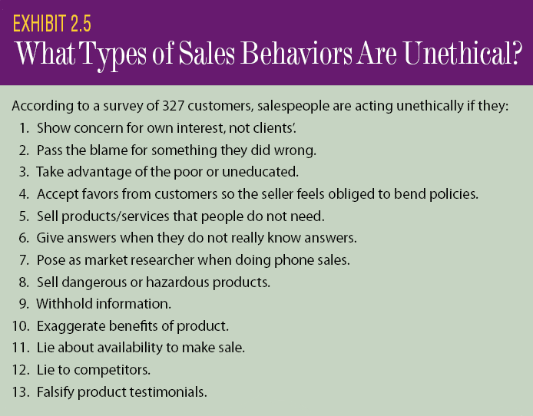
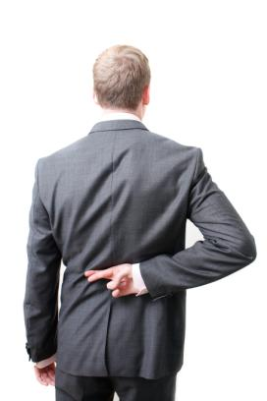
Unethical Behavior

Slide 28
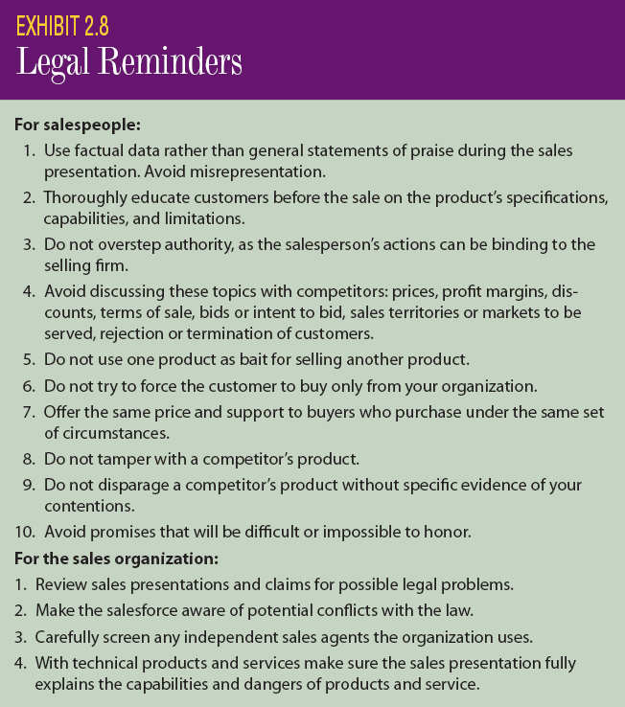
Advice for Salespeople

Slide 29
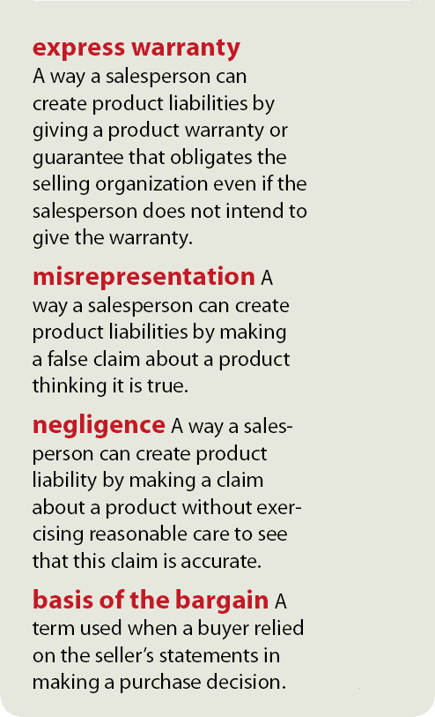
NonCustomer-Oriented Behavior

Slide 30
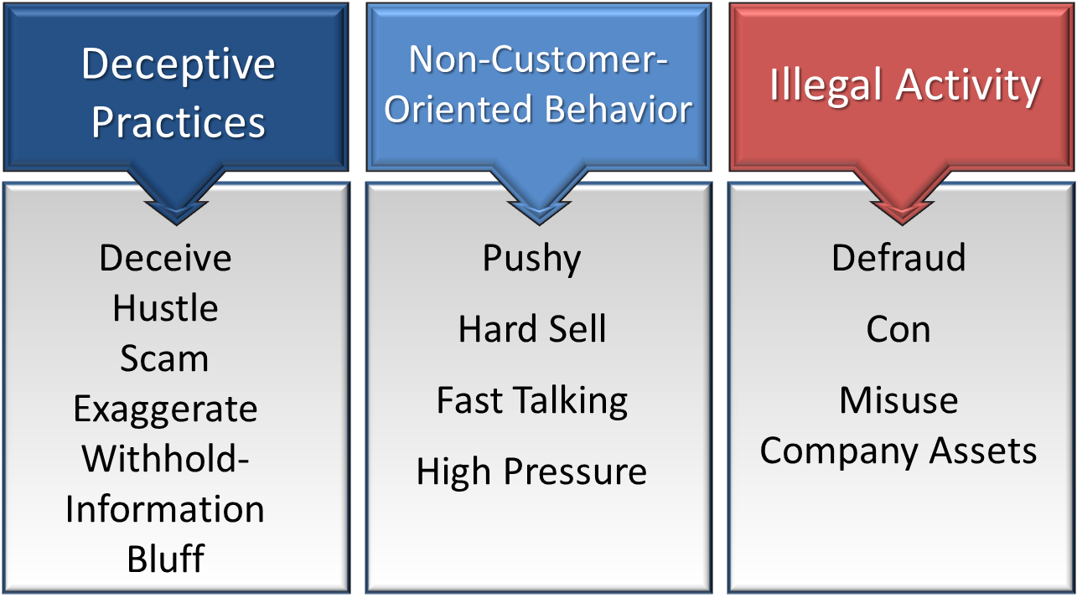
Categories of Unethical Behavior

